Slide 1
Distributed Database System
IF5030 Manajemen Informasi
Sem. 1 2014/2015

Slide 2
Objectives
Mahasiswa mengerti dan memahami tentang konsep Sistem Basis Data Terdistribusi
Mahasiswa mengerti dan memahami kelebihan dan kelemahan Sistem Basis Data Terdistribusi yang ada
Mahasiswa mampu mengetahui isu yang berkembang dalam domain Sistem Basis Data Terdistribusi

Slide 3
Referensi
Abraham Silberschatz, Henry F. Korth, S. Sudarshan. Database System Concepts: 5th Edition. McGraw-Hill. 2005
M. Tamer Ozsu, Distributed Database Management System. School of Computer Science at the University of Waterloo. 2001

Slide 4
Outline
Heterogeneous and Homogeneous Databases
Distributed Data Storage
Distributed Transactions
Commit Protocols
Concurrency Control in Distributed Databases
Availability
Open Issue

Slide 5
Distributed Database System
A distributed database (DDB) is a collection of multiple, logically interrelated databases distributed over a computer network.
A distributed database management system (D–DBMS) is the software that manages the DDB and provides an access mechanism that makes this distribution transparent to the users.
Distributed database system (DDBS) = DDB + D–DBMS

Slide 6
Homogeneous Distributed Databases
In a homogeneous distributed database
All sites have identical software
Are aware of each other and agree to cooperate in processing user requests.
Each site surrenders part of its autonomy in terms of right to change schemas or software
Appears to user as a single system
In a heterogeneous distributed database
Different sites may use different schemas and software
Difference in schema is a major problem for query processing
Difference in software is a major problem for transaction processing
Sites may not be aware of each other and may provide only limited facilities for cooperation in transaction processing

Slide 7
Data Replication
A relation or fragment of a relation is replicated if it is stored redundantly in two or more sites.
Full replication of a relation is the case where the relation is stored at all sites.
Fully redundant databases are those in which every site contains a copy of the entire database.

Slide 8
Data Replication (Cont.)
Advantages of Replication
Availability: failure of site containing relation r does not result in unavailability of r is replicas exist.
Parallelism: queries on r may be processed by several nodes in parallel.
Reduced data transfer: relation r is available locally at each site containing a replica of r.
Disadvantages of Replication
Increased cost of updates: each replica of relation r must be updated.
Increased complexity of concurrency control: concurrent updates to distinct replicas may lead to inconsistent data unless special concurrency control mechanisms are implemented.
One solution: choose one copy as primary copy and apply concurrency control operations on primary copy

Slide 9
Data Fragmentation
Division of relation r into fragments r₁, r₂, …, r_{n} which contain sufficient information to reconstruct relation r.
Horizontal fragmentation: each tuple of r is assigned to one or more fragments
Vertical fragmentation: the schema for relation r is split into several smaller schemas
All schemas must contain a common candidate key (or superkey) to ensure lossless join property.
A special attribute, the tuple-id attribute may be added to each schema to serve as a candidate key.
Example : relation account with following schema
Account = (account_number, branch_name , balance )

Slide 10
Horizontal Fragmentation of account Relation
account_number
branch_name
balance
A-305
A-226
A-155
Hillside
Hillside
Hillside
500
336
62
account₁ = σ_{branch_name=“Hillside”} (account )
account_number
branch_name
balance
A-177
A-402
A-408
A-639
Valleyview
Valleyview
Valleyview
Valleyview
205
10000
1123
750
account₂ = σ_{branch_name=“Valleyview”} (account )

Slide 11
Vertical Fragmentation of employee_info Relation
branch_name
customer_name
tuple_id
Hillside
Hillside
Valleyview
Valleyview
Hillside
Valleyview
Valleyview
Lowman
Camp
Camp
Kahn
Kahn
Kahn
Green
1
2
3
4
5
6
7
deposit₁ = Πbranch_name, customer_name, tuple_id (employee_info )
account_number
balance
tuple_id
A-305
A-226
A-177
A-402
A-155
A-408
A-639
500
336
205
10000
62
1123
750
1
2
3
4
5
6
7
deposit₂ = Πaccount_number, balance, tuple_id (employee_info )

Slide 12
Advantages of Fragmentation
Horizontal:
allows parallel processing on fragments of a relation
allows a relation to be split so that tuples are located where they are most frequently accessed
Vertical:
allows tuples to be split so that each part of the tuple is stored where it is most frequently accessed
tuple-id attribute allows efficient joining of vertical fragments
Vertical and horizontal fragmentation can be mixed.
Fragments may be successively fragmented to an arbitrary depth.
Replication and fragmentation can be combined
Relation is partitioned into several fragments: system maintains several identical replicas of each such fragment.

Slide 13
Data Transparency
Data transparency: Degree to which system user may remain unaware of the details of how and where the data items are stored in a distributed system
Consider transparency issues in relation to:
Fragmentation transparency
Replication transparency
Location transparency
Naming of data items: criteria
Every data item must have a system-wide unique name.
It should be possible to find the location of data items efficiently.
It should be possible to change the location of data items transparently.
Each site should be able to create new data items autonomously.

Slide 14
Centralized Scheme - Name Server
Structure:
name server assigns all names
each site maintains a record of local data items
sites ask name server to locate non-local data items
Advantages:
satisfies naming criteria 1-3
Disadvantages:
does not satisfy naming criterion 4
name server is a potential performance bottleneck
name server is a single point of failure

Slide 15
Use of Aliases
Alternative to centralized scheme: each site prefixes its own site identifier to any name that it generates i.e., site 17.account.
Fulfills having a unique identifier, and avoids problems associated with central control.
However, fails to achieve network transparency.
Solution: Create a set of aliases for data items; Store the mapping of aliases to the real names at each site.
The user can be unaware of the physical location of a data item, and is unaffected if the data item is moved from one site to another.

Slide 16
Distributed Transactions
Transaction may access data at several sites.
Each site has a local transaction manager responsible for:
Maintaining a log for recovery purposes
Participating in coordinating the concurrent execution of the transactions executing at that site.
Each site has a transaction coordinator, which is responsible for:
Starting the execution of transactions that originate at the site.
Distributing subtransactions at appropriate sites for execution.
Coordinating the termination of each transaction that originates at the site, which may result in the transaction being committed at all sites or aborted at all sites.

Slide 17
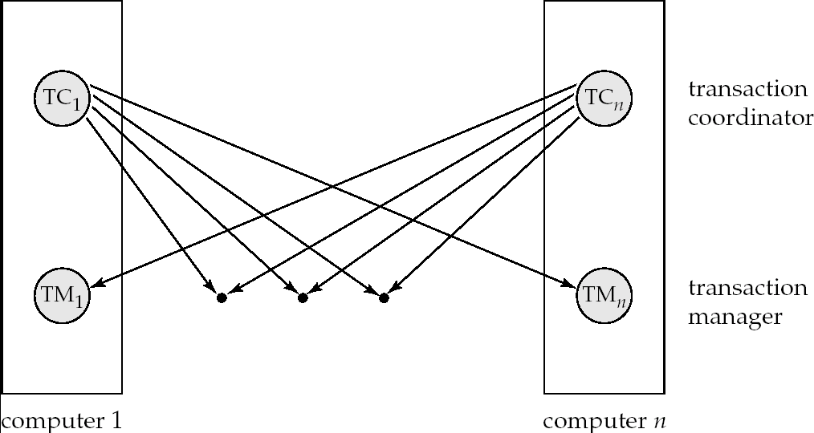
Transaction System Architecture

Slide 18
System Failure Modes
Failures unique to distributed systems:
Failure of a site.
Loss of messages
Handled by network transmission control protocols such as TCP-IP
Failure of a communication link
Handled by network protocols, by routing messages via alternative links
Network partition
A network is said to be partitioned when it has been split into two or more subsystems that lack any connection between them
Note: a subsystem may consist of a single node
Network partitioning and site failures are generally indistinguishable.

Slide 19
Commit Protocols
Commit protocols are used to ensure atomicity across sites
a transaction which executes at multiple sites must either be committed at all the sites, or aborted at all the sites.
not acceptable to have a transaction committed at one site and aborted at another
The two-phase commit (2PC) protocol is widely used
The three-phase commit (3PC) protocol is more complicated and more expensive, but avoids some drawbacks of two-phase commit protocol. This protocol is not used in practice.

Slide 20
Two Phase Commit Protocol (2PC)
Assumes fail-stop model – failed sites simply stop working, and do not cause any other harm, such as sending incorrect messages to other sites.
Execution of the protocol is initiated by the coordinator after the last step of the transaction has been reached.
The protocol involves all the local sites at which the transaction executed
Let T be a transaction initiated at site S_{i}, and let the transaction coordinator at S_{i} be C_{i}

Slide 21
Phase 1: Obtaining a Decision
Coordinator asks all participants to prepare to commit transaction T_{i}.
C_{i} adds the records <prepare T> to the log and forces log to stable storage
sends prepare T messages to all sites at which T executed
Upon receiving message, transaction manager at site determines if it can commit the transaction
if not, add a record <no T> to the log and send abort T message to C_{i}
if the transaction can be committed, then:
add the record <ready T> to the log
force all records for T to stable storage
send ready T message to C_{i}

Slide 22
Phase 2: Recording the Decision
T can be committed of C_{i} received a ready T message from all the participating sites: otherwise T must be aborted.
Coordinator adds a decision record, <commit T> or <abort T>, to the log and forces record onto stable storage. Once the record stable storage it is irrevocable (even if failures occur)
Coordinator sends a message to each participant informing it of the decision (commit or abort)
Participants take appropriate action locally.

Slide 23
Handling of Failures - Site Failure
When site S_{i} recovers, it examines its log to determine the fate of
transactions active at the time of the failure.
Log contain <commit T> record: site executes redo (T)
Log contains <abort T> record: site executes undo (T)
Log contains <ready T> record: site must consult C_{i} to determine the fate of T.
If T committed, redo (T)
If T aborted, undo (T)
The log contains no control records concerning T
implies that S_{k} failed before responding to the prepare T message from C_{i}
S_{k} must execute undo (T)

Slide 24
Handling of Failures- Coordinator Failure
If coordinator fails while the commit protocol for T is executing then participating sites must decide on T’s fate:
If an active site contains a <commit T> record in its log, then T must be committed.
If an active site contains an <abort T> record in its log, then T must be aborted.
If some active participating site does not contain a <ready T> record in its log, then the failed coordinator C_{i} cannot have decided to commit T.
Can therefore abort T.
If none of the above cases holds, then all active sites must have a <ready T> record in their logs, but no additional control records (such as <abort T> of <commit T>).
In this case active sites must wait for C_{i} to recover, to find decision.
Blocking problem: active sites may have to wait for failed coordinator to recover.

Slide 25
Handling of Failures - Network Partition
If the coordinator and all its participants remain in one partition, the failure has no effect on the commit protocol.
If the coordinator and its participants belong to several partitions:
Sites that are not in the partition containing the coordinator think the coordinator has failed, and execute the protocol to deal with failure of the coordinator.
No harm results, but sites may still have to wait for decision from coordinator.
The coordinator and the sites are in the same partition as the coordinator think that the sites in the other partition have failed, and follow the usual commit protocol.
Again, no harm results

Slide 26
Recovery and Concurrency Control
In-doubt transactions have a <ready T>, but neither a <commit T>, nor an <abort T> log record.
The recovering site must determine the commit-abort status of such transactions by contacting other sites; this can slow and potentially block recovery.
Recovery algorithms can note lock information in the log.
Instead of <ready T>, write out <ready T, L> L = list of locks held by T when the log is written (read locks can be omitted).
For every in-doubt transaction T, all the locks noted in the <ready T, L> log record are reacquired.
After lock reacquisition, transaction processing can resume; the commit or rollback of in-doubt transactions is performed concurrently with the execution of new transactions.

Slide 27
Alternative Models of Transaction Processing
Notion of a single transaction spanning multiple sites is inappropriate for many applications
E.g. transaction crossing an organizational boundary
No organization would like to permit an externally initiated transaction to block local transactions for an indeterminate period
Alternative models carry out transactions by sending messages
Code to handle messages must be carefully designed to ensure atomicity and durability properties for updates
Isolation cannot be guaranteed
but code must ensure no inconsistent states result due to concurrency
Persistent messaging systems are systems that provide transactional properties to messages
Messages are guaranteed to be delivered exactly once
Will discuss implementation techniques later

Slide 28
Alternative Models (Cont.)
Motivating example: funds transfer between two banks
Two phase commit would have the potential to block updates on the accounts involved in funds transfer
Alternative solution:
Debit money from source account and send a message to other site
Site receives message and credits destination account
Messaging has long been used for distributed transactions (even before computers were invented!)
Atomicity issue
once transaction sending a message is committed, message must guaranteed to be delivered
Guarantee as long as destination site is up and reachable, code to handle undeliverable messages must also be available
e.g. credit money back to source account.
If sending transaction aborts, message must not be sent

Slide 29
Error Conditions with Persistent Messaging
Code to handle messages has to take care of variety of failure situations (even assuming guaranteed message delivery)
E.g. if destination account does not exist, failure message must be sent back to source site
When failure message is received from destination site, or destination site itself does not exist, money must be deposited back in source account
Problem if source account has been closed
get humans to take care of problem
User code executing transaction processing using 2PC does not have to deal with such failures
There are many situations where extra effort of error handling is worth the benefit of absence of blocking
E.g. pretty much all transactions across organizations

Slide 30
Persistent Messaging and Workflows
Workflows provide a general model of transactional processing involving multiple sites and possibly human processing of certain steps
E.g. when a bank receives a loan application, it may need to
Contact external credit-checking agencies
Get approvals of one or more managers
and then respond to the loan application
We study workflows in Chapter 25
Persistent messaging forms the underlying infrastructure for workflows in a distributed environment

Slide 31
Concurrency Control
Modify concurrency control schemes for use in distributed environment.
We assume that each site participates in the execution of a commit protocol to ensure global transaction automicity.
We assume all replicas of any item are updated
Will see how to relax this in case of site failures later

Slide 32
Single-Lock-Manager Approach
System maintains a single lock manager that resides in a single chosen site, say S_{i}
When a transaction needs to lock a data item, it sends a lock request to S_{i} and lock manager determines whether the lock can be granted immediately
If yes, lock manager sends a message to the site which initiated the request
If no, request is delayed until it can be granted, at which time a message is sent to the initiating site

Slide 33
Single-Lock-Manager Approach (Cont.)
The transaction can read the data item from any one of the sites at which a replica of the data item resides.
Writes must be performed on all replicas of a data item
Advantages of scheme:
Simple implementation
Simple deadlock handling
Disadvantages of scheme are:
Bottleneck: lock manager site becomes a bottleneck
Vulnerability: system is vulnerable to lock manager site failure.

Slide 34
Distributed Lock Manager
In this approach, functionality of locking is implemented by lock managers at each site
Lock managers control access to local data items
But special protocols may be used for replicas
Advantage: work is distributed and can be made robust to failures
Disadvantage: deadlock detection is more complicated
Lock managers cooperate for deadlock detection
More on this later
Several variants of this approach
Primary copy
Majority protocol
Biased protocol
Quorum consensus

Slide 35
Primary Copy
Choose one replica of data item to be the primary copy.
Site containing the replica is called the primary site for that data item
Different data items can have different primary sites
When a transaction needs to lock a data item Q, it requests a lock at the primary site of Q.
Implicitly gets lock on all replicas of the data item
Benefit
Concurrency control for replicated data handled similarly to unreplicated data - simple implementation.
Drawback
If the primary site of Q fails, Q is inaccessible even though other sites containing a replica may be accessible.

Slide 36
Majority Protocol
Local lock manager at each site administers lock and unlock requests for data items stored at that site.
When a transaction wishes to lock an unreplicated data item Q residing at site S_{i}, a message is sent to S_{i} ‘s lock manager.
If Q is locked in an incompatible mode, then the request is delayed until it can be granted.
When the lock request can be granted, the lock manager sends a message back to the initiator indicating that the lock request has been granted.

Slide 37
Majority Protocol (Cont.)
In case of replicated data
If Q is replicated at n sites, then a lock request message must be sent to more than half of the n sites in which Q is stored.
The transaction does not operate on Q until it has obtained a lock on a majority of the replicas of Q.
When writing the data item, transaction performs writes on all replicas.
Benefit
Can be used even when some sites are unavailable
details on how handle writes in the presence of site failure later
Drawback
Requires 2(n/2 + 1) messages for handling lock requests, and (n/2 + 1) messages for handling unlock requests.
Potential for deadlock even with single item - e.g., each of 3 transactions may have locks on 1/3rd of the replicas of a data.

Slide 38
Biased Protocol
Local lock manager at each site as in majority protocol, however, requests for shared locks are handled differently than requests for exclusive locks.
Shared locks. When a transaction needs to lock data item Q, it simply requests a lock on Q from the lock manager at one site containing a replica of Q.
Exclusive locks. When transaction needs to lock data item Q, it requests a lock on Q from the lock manager at all sites containing a replica of Q.
Advantage - imposes less overhead on read operations.
Disadvantage - additional overhead on writes

Slide 39
Quorum Consensus Protocol
A generalization of both majority and biased protocols
Each site is assigned a weight.
Let S be the total of all site weights
Choose two values read quorum Q_{r} and write quorum Q_{w}
Such that Q_{r} + Q_{w} > S and 2 * Q_{w} > S
Quorums can be chosen (and S computed) separately for each item
Each read must lock enough replicas that the sum of the site weights is >= Q_{r}
Each write must lock enough replicas that the sum of the site weights is >= Q_{w}
For now we assume all replicas are written
Extensions to allow some sites to be unavailable described later

Slide 40
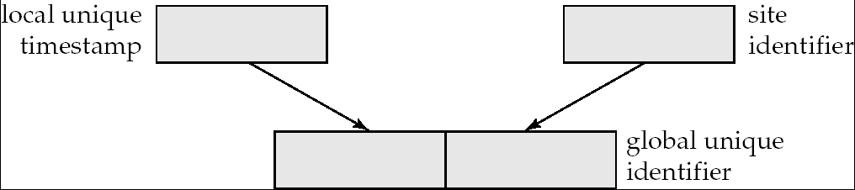
Timestamping
Timestamp based concurrency-control protocols can be used in distributed systems
Each transaction must be given a unique timestamp
Main problem: how to generate a timestamp in a distributed fashion
Each site generates a unique local timestamp using either a logical counter or the local clock.
Global unique timestamp is obtained by concatenating the unique local timestamp with the unique identifier.

Slide 41
Timestamping (Cont.)
A site with a slow clock will assign smaller timestamps
Still logically correct: serializability not affected
But: “disadvantages” transactions
To fix this problem
Define within each site S_{i} a logical clock (LC_{i}), which generates the unique local timestamp
Require that S_{i} advance its logical clock whenever a request is received from a transaction Ti with timestamp < x,y> and x is greater that the current value of LC_{i}.
In this case, site S_{i} advances its logical clock to the value x + 1.

Slide 42
Replication with Weak Consistency
Many commercial databases support replication of data with weak degrees of consistency (I.e., without a guarantee of serializabiliy)
E.g.: master-slave replication: updates are performed at a single “master” site, and propagated to “slave” sites.
Propagation is not part of the update transaction: its is decoupled
May be immediately after transaction commits
May be periodic
Data may only be read at slave sites, not updated
No need to obtain locks at any remote site
Particularly useful for distributing information
E.g. from central office to branch-office
Also useful for running read-only queries offline from the main database

Slide 43
Replication with Weak Consistency (Cont.)
Replicas should see a transaction-consistent snapshot of the database
That is, a state of the database reflecting all effects of all transactions up to some point in the serialization order, and no effects of any later transactions.
E.g. Oracle provides a create snapshot statement to create a snapshot of a relation or a set of relations at a remote site
snapshot refresh either by recomputation or by incremental update
Automatic refresh (continuous or periodic) or manual refresh

Slide 44
Multimaster and Lazy Replication
With multimaster replication (also called update-anywhere replication) updates are permitted at any replica, and are automatically propagated to all replicas
Basic model in distributed databases, where transactions are unaware of the details of replication, and database system propagates updates as part of the same transaction
Coupled with 2 phase commit
Many systems support lazy propagation where updates are transmitted after transaction commits
Allows updates to occur even if some sites are disconnected from the network, but at the cost of consistency

Slide 45
Deadlock Handling
Consider the following two transactions and history, with item X and transaction T₁ at site 1, and item Y and transaction T₂ at site 2:
T₁: write (X)
write (Y)
T₂: write (Y)
write (X)
X-lock on X
write (X)
X-lock on Y
write (Y)
wait for X-lock on X
Wait for X-lock on Y
Result: deadlock which cannot be detected locally at either site

Slide 46
Centralized Approach
A global wait-for graph is constructed and maintained in a single site; the deadlock-detection coordinator
Real graph: Real, but unknown, state of the system.
Constructed graph:Approximation generated by the controller during the execution of its algorithm .
the global wait-for graph can be constructed when:
a new edge is inserted in or removed from one of the local wait-for graphs.
a number of changes have occurred in a local wait-for graph.
the coordinator needs to invoke cycle-detection.
If the coordinator finds a cycle, it selects a victim and notifies all sites. The sites roll back the victim transaction.

Slide 47
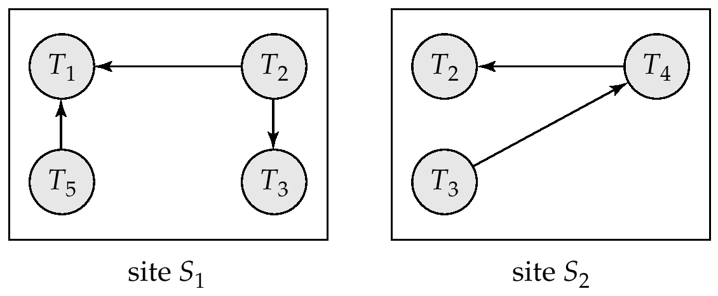
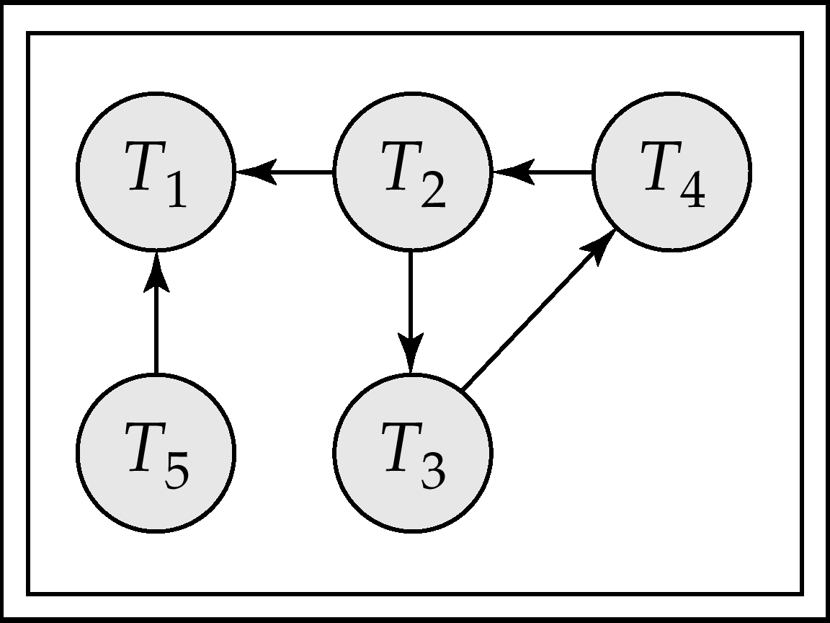
Local and Global Wait-For Graphs
Local
Global

Slide 48
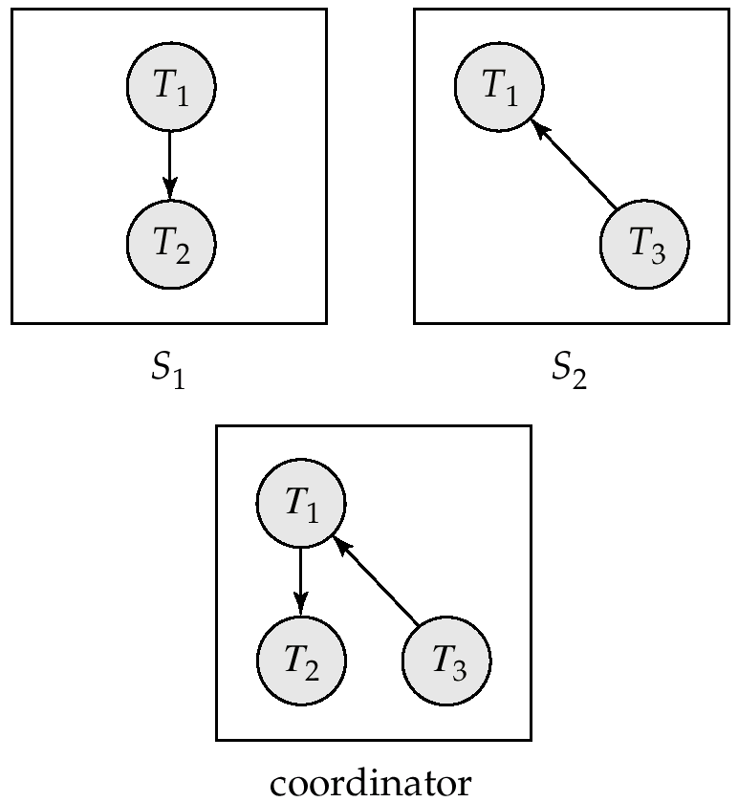
Example Wait-For Graph for False Cycles
Initial state:

Slide 49
False Cycles (Cont.)
Suppose that starting from the state shown in figure,
1. T₂ releases resources at S₁
resulting in a message remove T₁ → T₂ message from the Transaction Manager at site S₁ to the coordinator)
2. And then T₂ requests a resource held by T₃ at site S₂
resulting in a message insert T₂ → T₃ from S₂ to the coordinator
Suppose further that the insert message reaches before the delete message
this can happen due to network delays
The coordinator would then find a false cycle
T₁ → T₂ → T₃ → T₁
The false cycle above never existed in reality.
False cycles cannot occur if two-phase locking is used.

Slide 50
Unnecessary Rollbacks
Unnecessary rollbacks may result when deadlock has indeed occurred and a victim has been picked, and meanwhile one of the transactions was aborted for reasons unrelated to the deadlock.
Unnecessary rollbacks can result from false cycles in the global wait-for graph; however, likelihood of false cycles is low.

Slide 51
Availability
High availability: time for which system is not fully usable should be extremely low (e.g. 99.99% availability)
Robustness: ability of system to function spite of failures of components
Failures are more likely in large distributed systems
To be robust, a distributed system must
Detect failures
Reconfigure the system so computation may continue
Recovery/reintegration when a site or link is repaired
Failure detection: distinguishing link failure from site failure is hard
(partial) solution: have multiple links, multiple link failure is likely a site failure

Slide 52
Open Issue
Distributed Database Design
how to distribute the database
replicated & non-replicated database distribution
a related problem in directory management
Query Processing
convert user transactions to data manipulation instructions
optimization problem
min{cost = data transmission + local processing}
general formulation is NP-hard

Slide 53
Open Issue (cont.)
Concurrency Control
synchronization of concurrent accesses
consistency and isolation of transactions' effects
deadlock management
Reliability
how to make the system resilient to failures
atomicity and durability

